Slide 1
Tcl Status Update
Donal Fellows
EuroTcl 2014

Slide 2

Tcl Status
Public view

Slide 3
Current Release Status
Releases
Distribution
Tcl/Tk 8.6.1 “Production”
  Released: 2013-09-20
  Fossil tag: core-8-6-1
Tcl/Tk 8.5.15 “Stable”
  Released: 2013-09-18
  Fossil tag: core-8-5-15
Tcl/Tk 8.4.20 “Legacy”
  Released: 2013-06-01
  End of Life
    No more support
    Not even security fixes
  Fossil tag: core-8-4-20
Source distribution channels
  SourceForge
  Launchpad
Binary distributions
  ActiveTcl
  Tclkit ecosystem
  In some operating systems
    Linux
    OSX

Slide 4
Current Support Status
Support Channels
Key Websites
comp.lang.tcl
  Web forum bridges
    www.kroc.tk/forum
    Google Groups
Social media
  Google+
  Facebook
Q&A on StackOverflow
  Most questions answered in hours
    More help needed for Expect and NS2
tcl-core mailing list
  Not for general community questions
Examples on Rosetta Code
Main Site
  www.tcl.tk
  Public Facing
  Documentation
  Tutorial
Community Wiki
  wiki.tcl.tk
Development Site
  core.tcl.tk (replicated)
  Fossil
    Source, bug database

Slide 5
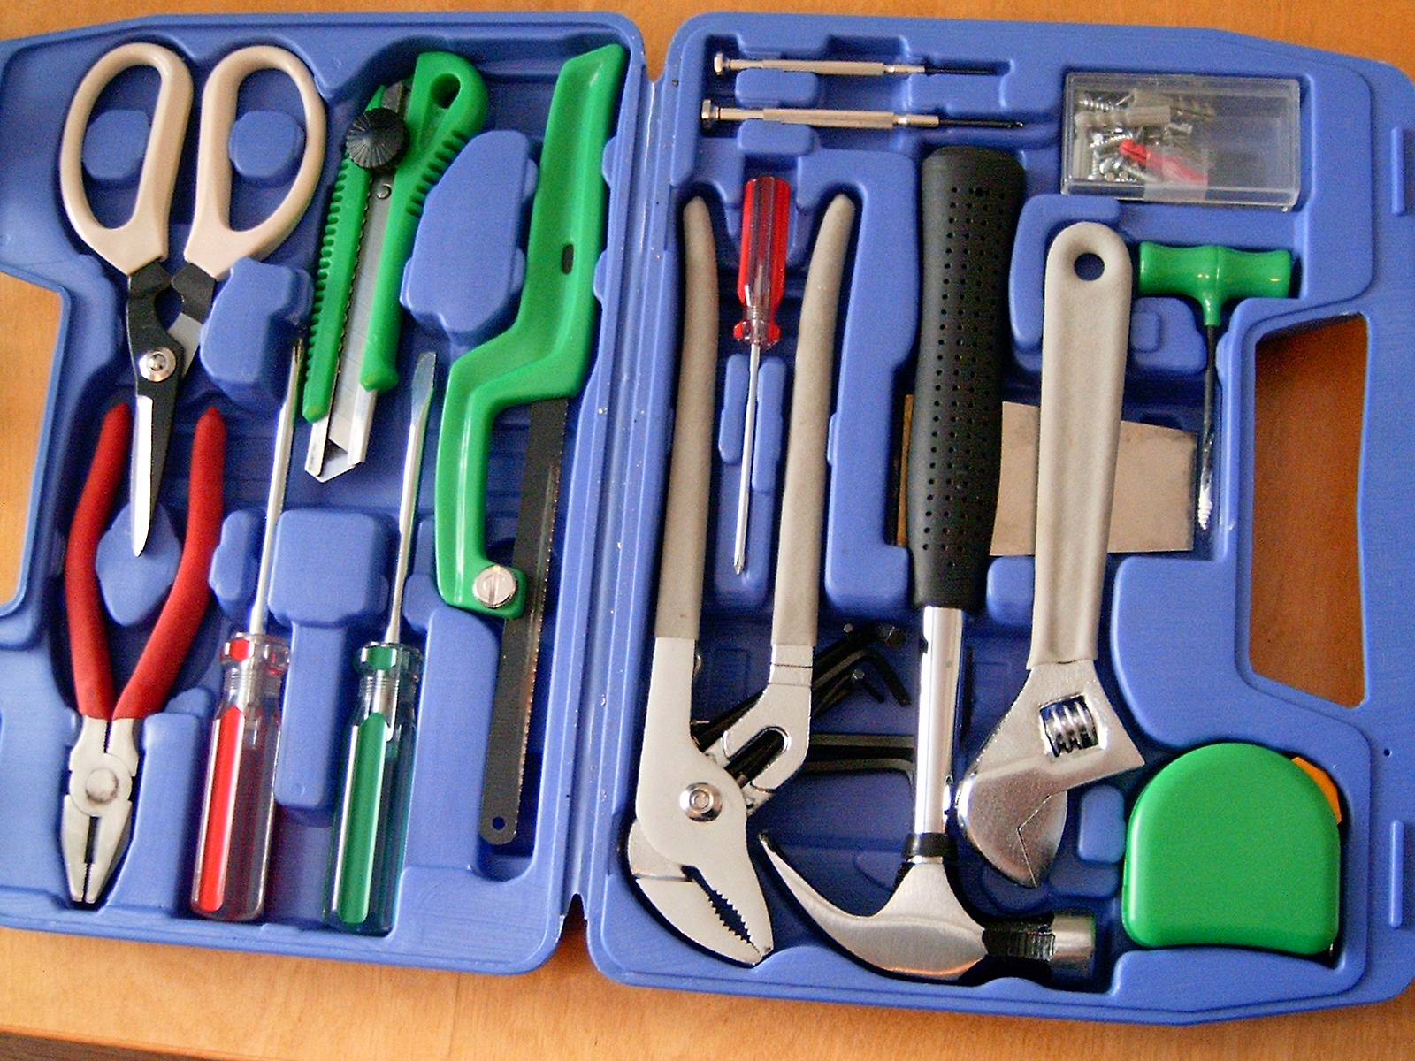
Tcl Status
Developers’ view

Slide 6
Current Development Status
Mostly quiet since start of 2014
  Too much real life!
Bugfixing on 8.5 and 8.6
  Improvements to IPv4/v6 switching
  Number of other I/O bugs
  Compilation bugs
  General error message consistency
  Portability fixes
Tcl 9.0 development started
  Fossil branch: novem
  Cleaning out old API
  Working towards fully 64-bit-capable API
    Large memory allocations

Slide 7
On the Horizon
Compilation of Tcl to Native Code
  So far, showed that it is possible in principle
    Paper example: simple math function cos()
  Plan
    Start from Tcl bytecode compiler
      SSA IR with type analysis
      C or LLVM IR
      native code
    Fall back to bytecode or interpretation if things too nasty
  So far, got the bytecode decompiler, an inference engine, and some tooling
    Not yet integrated

Slide 8
On the Horizon
Many proposed TIPs… my selection
  TIP #198: Image Command XPM Extension
  TIP #262: Background Images for Frames
  TIP #288: Allow "args" Anywhere in Procedure Formal Arguments
  TIP #309: Expose the Expression Parsing
  TIP #384: Add File Alteration Monitoring
  TIP #390: A Logging API
  TIP #405: "C" is for Cookie
  TIP #409: UDP in Tcl
  TIP #411: Improved Channel Introspection via "chan info"
  TIP #415: Enable Easy Creation of Circular Arc Segments
  TIP #424: Improving [exec]
  TIP #426: Determining the "Type" of Commands

Slide 9

Tcl Status
Community view

Slide 10
Wider Community
Rani Ahmed’s tutorial videos
Just because it isn’t in “the core” doesn’t mean it isn’t worth consideration
  The best, most universal stuff can be co-distributed
AndroWish
  More platforms!
VecTcl looks really awesome
  Effectively supersedes several TIPs!
Not everything that is “Tcl” is Tcl
  Hecl, Jim, Eagle…

